Slide 1
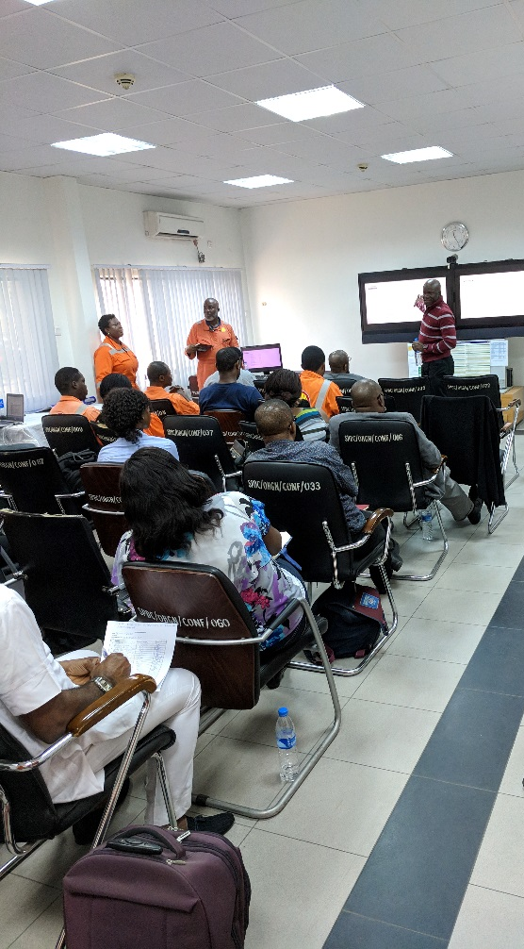
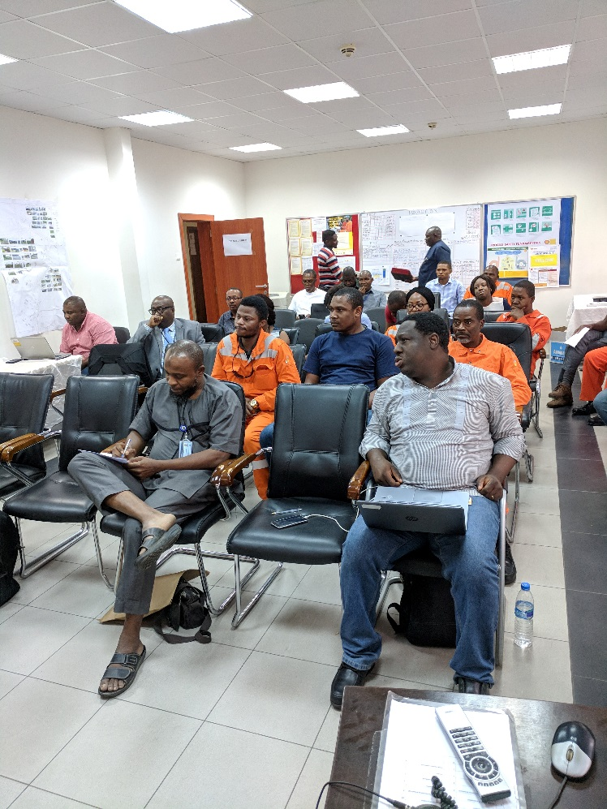
2018 OBIGBO STRATEGIC PLANNING WORKSHOP REPORT

Slide 2
THE 4 KEY AREAS
People
Safety
Motivated & Empowered people
Salaries & Payments% on time: zero backlog
Goal Zero:
No Harm
No Leaks
Deepen Safety Leadership journey in 2018
People development; cross functional growth
Focus on personal health and wellbeing
Improve Peer to Peer Intervention
Maintain adequate OSR materials
Grow IPSC by ca. 5.6kbopd by end 2018
Deliver new conduits post de-encroachment
Achieve 26% reduction in OP 17 OPEX %
Reduce daily logistics shuttle to optimize cost
Achieve top quartile equipment availability
Improve gas quality delivered to customers
Implement DiY initiatives to optimize cost
Save ca. $1.2M from cost savings initiatives
Cost Optimization
Production

Slide 3
PEOPLE/SAFETY (GOAL ZERO)
Measure | Plan
23 | As per PUM MFE plan
18 | As per PUM HSE Drill Plan
26 | 1 per crew/month
52 | 1 per week
1 | Feb-18
4 | 1 per quarter
52 | Daily
10 | 10 per day
26 | 1 per crew/month
< 10%
PUM/TL MFEs
HSE Drills
Bi-Weekly HSE Meetings
Be Well Exercise
Safety Leadership
Contractor HSE Meeting
LFI/LSR/PSF Cascades
Daily UA/UC Reporting
Hazard Hunt
UA/UC Closed Actions

Slide 4
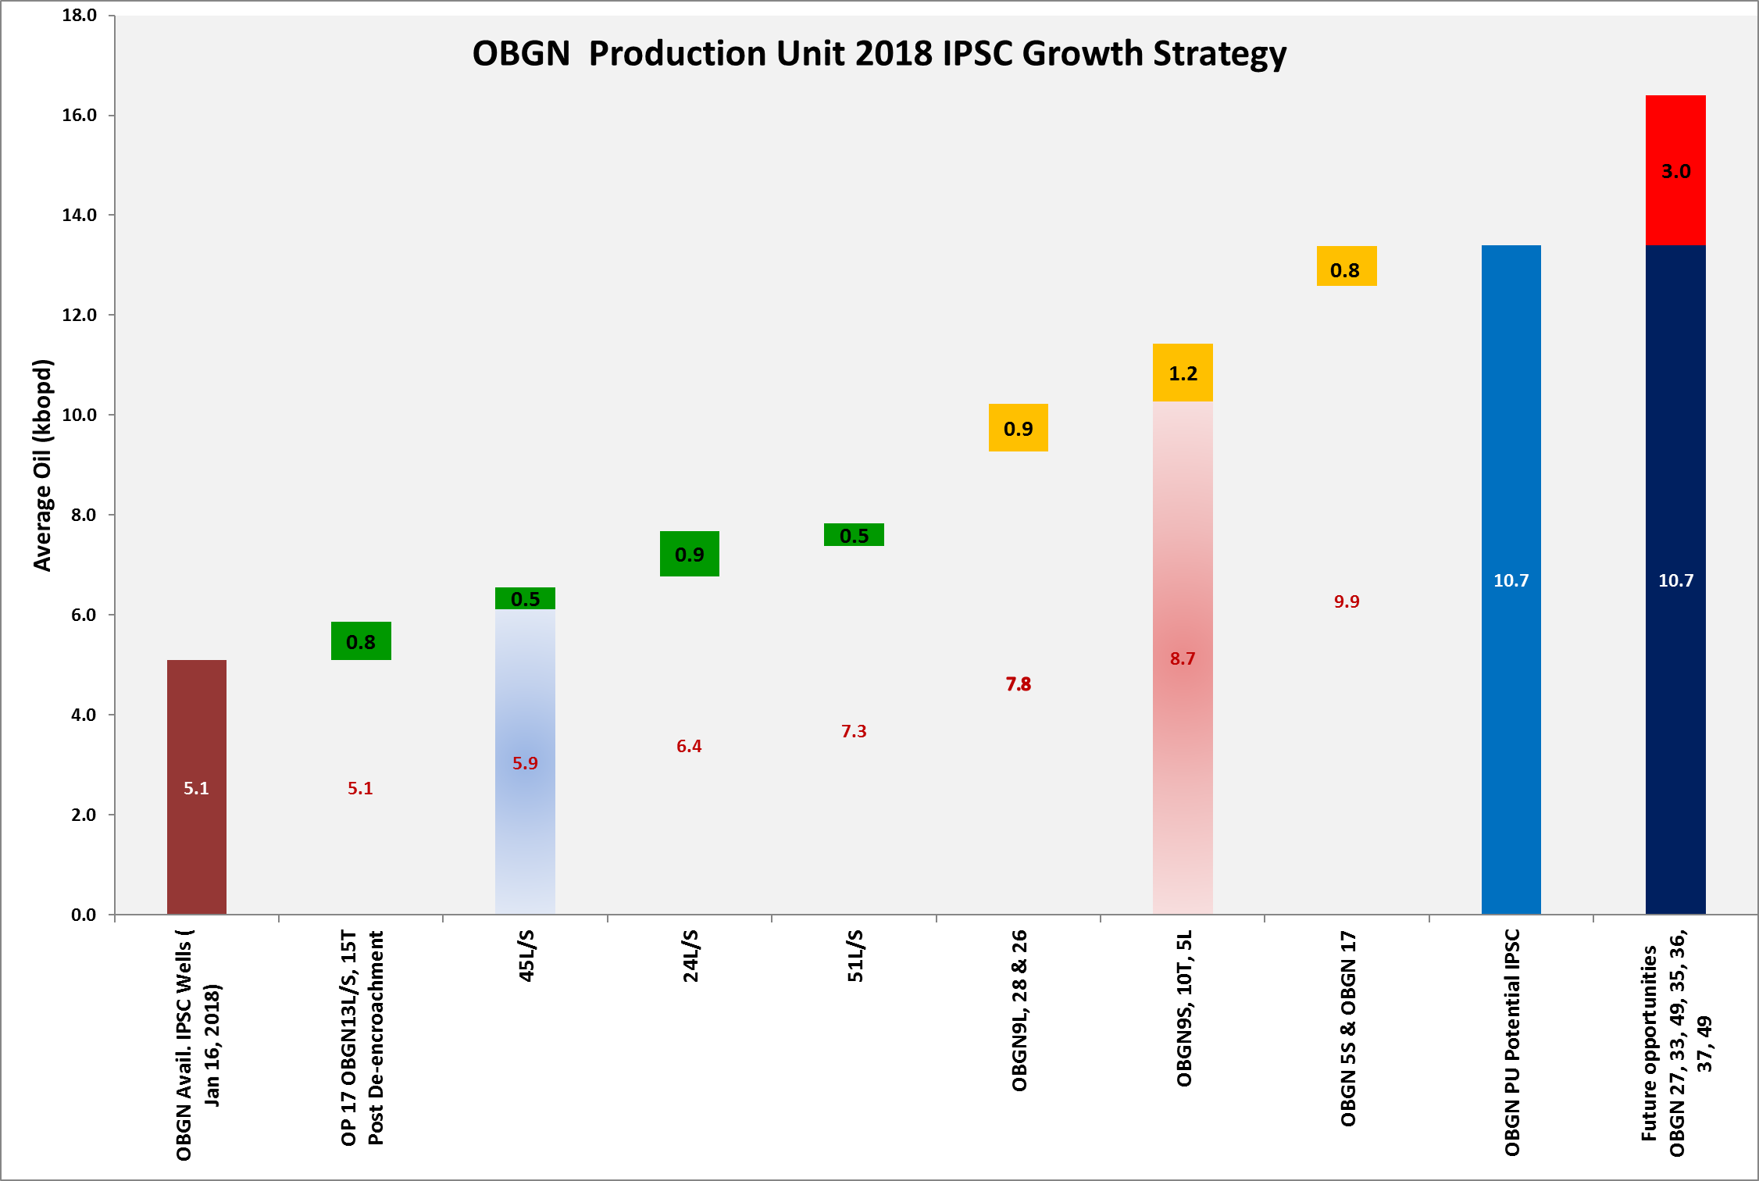
IPSC GROWTH PLAN & ENABLERS
Current IPSC for Obigbo PU is 5.1kbopd (as at January 2018)
OP17 IPSC plan peaks at 10.7 kbopd in Dec. ‘18.
Future opportunities of ca. 3kbopd available for further IPSC growth
Deliver ca. 1.2kbopd by Q1 2018 post de-encroachment
Cost required Q1
WRFM restoration and optimization activities with additional 1.4kbopd in Q2 2018
Cost required Q2
Additional 1kbopd post Right of Way restoration and de-encroachment for OBGN9L, 28 and 26
Target .2kbopd from PSOs
Wells classified as having medium potential to deliver additional ca. 2.9k barrels post de-encroachment and well intervention
10.7kbopd to be delivered by Q4 2018
Ca. 1.4kbopd to be added by Q2 2018
Addition of 5 conduits expected to deliver ca. 1.2kbopd by Q1 2018
13 conduits flowing available IPSC of 5.1kbopd
OP 17 IPSC 5.1kbopd
BP 17 Target 3.6kbopd

Slide 5
COST OPTIMISATION ROADMAP
S/N | Opportunities | Cost reduction Ambition $
1 | Chemical, Lubricants & Diesel cost savings | 168,000
2 | Flow station one bank optimization | 150,000
3 | Catering cost reduction | 200,000
4 | AGG UPS Autonomy Test | 100,000
5 | Optimize AGG Operations cost by 20% | 250,000
6 | Reduce daily logistics shuttle | 160,000
7 | Reduce export pumps in FS to 3 | 54,000
8 | 5 Yearly facility painting cost optimization | 50,000
9 | DiY monthly meter proving at FS | 48,000
10 | Other cost saving initiatives | 50,000
Total Savings |  | 1,230,000
26% cost savings from OP 17 OPEX

Slide 6
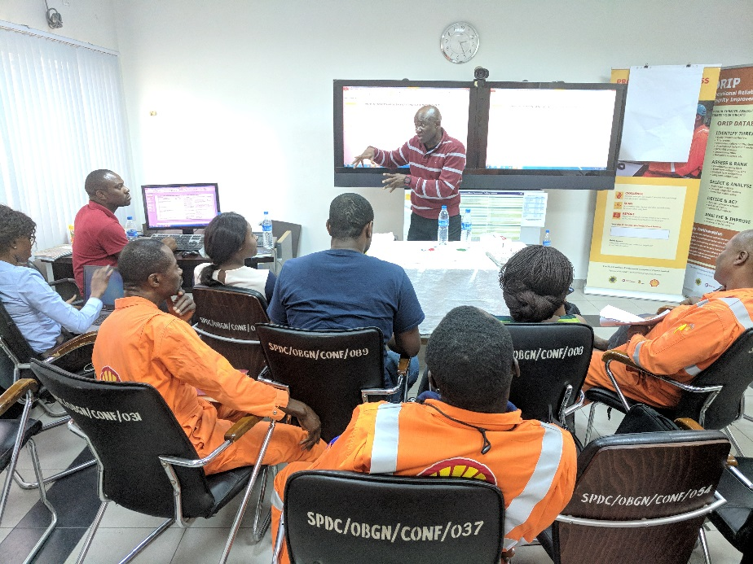
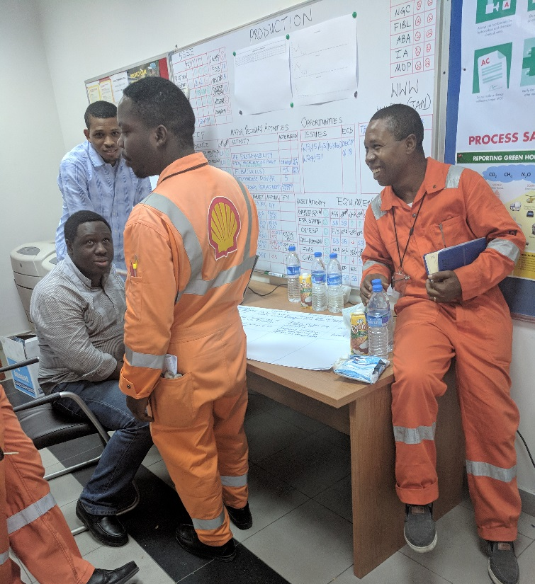
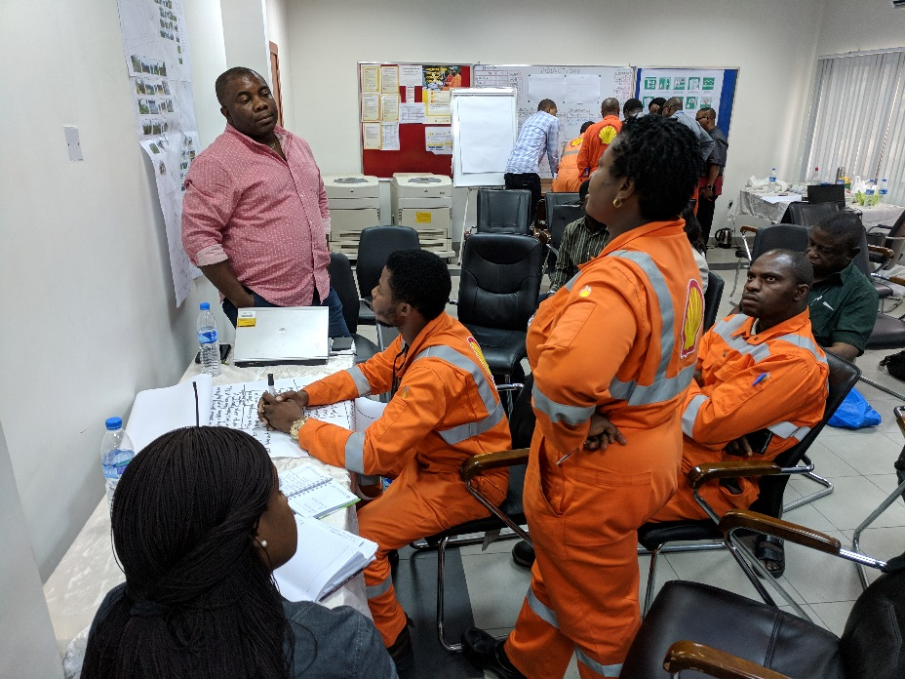
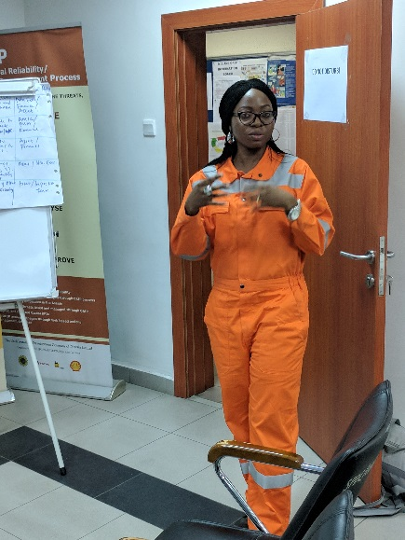
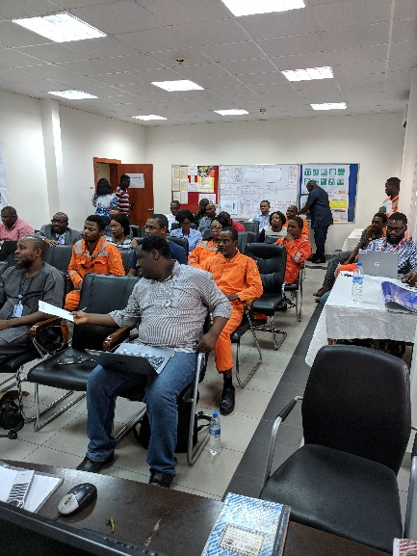
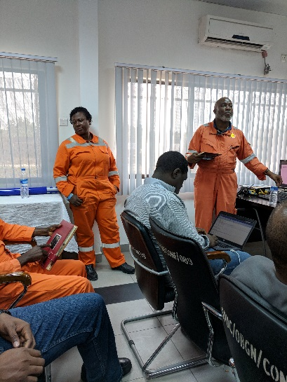
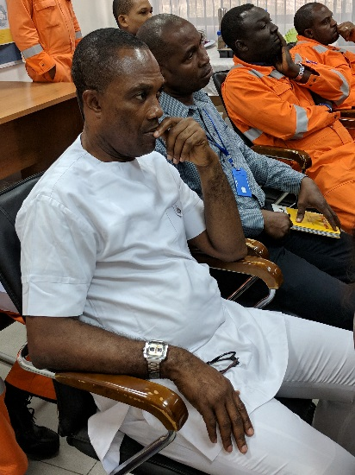
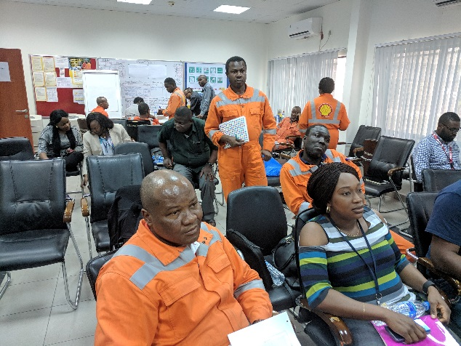
THE STRATEGY TEAM
Production/IPSC Growth
Cost Optimization
People/Safety

Slide 8
Detailed Breakdown of Opportunities
Syndicate Sessions
1.0

Slide 9
PRODUCTION GROWTH^{1/2}
 | Opportunities | Reward |  | Challenges |  | Recommendation/Improvement Plan | Action Party
 |  | Oil kbopd | Gas MMscf |  | Cost
1 | Increase oil production IPSC from existing 5.1kbopd to 15.5kbopd. Quick win: bean up W7L, 52T, 3T & 53 to unlock ca. 0.2kbopd CIWRS (ca. 29 conduits) categorized into high and medium potentials identified by Asset team with potential of delivering 10kbopd Existing condensate based off gas of 20mmscf/d from NAG (TBC) | 10.2 |  | Key challenges to maintaining existing IPSC of 5.1kbopd are long term deferment of W20T, 8T, 50T, 4T and 38L/S as well as the mean time to restore quit wells For the quick win: Confirmatory MER & DPR allowable needs to be ascertained Encroachment, availability of funds and execution capabilities are key challenges to delivering the oil in the 29 conduits. | TBD Majority of the well proposals have been developed and would be available by end Jan. 2018 | To sustain existing IPSC of 5.1kbopd: CWI to mobilize and restore production of quit wells FMT/WRFM to optimise potential from 4T and restoration of 38L/S Sustain quit Well approach to restore quit Wells To realise quick win: Conduct MER and obtain DPR allowable to realise quick win Validate increment gain for 52T as per PSO Close out bean up opportunities from PSO For the 29 conduits with various potentials Revalidate surface scope and opportunities for the closed in wells Prioritize opportunities based on potential from the wells. Implement robust de-encroachment strategy Make adequate funding available for restoration. Possible proposals incorporating extended scopes | AMIL WRFM/FMT CWI Asset Ops Team Pipeline/ROW Team De-encroachment Team
2 | Existing gas production potential of 45mmscf/d is available from NAG plant Uncertainty on dryness to wetness factor of 44T and 46T (ca. 20mmscf/d) Assurance of availability of W43T (ca. 10mmscf/d) Opportunity to optimize gas production from W44T Possible workover from W1T |  | 30 | Sampling points at 12’o clock position instead of 3 or 9’o clock position Liquid loading due to increased production No assurance yet on workover for W1T | TBD | Re-engineer sampling points Confirm actual dry gas potential through MRT for all gas wells Subsurface to engineer solution on liquid loading | AMIL WRFM/FMT CWI Asset Ops
3 | Existing water production potential of ca. 5kbwpd (W21T) Restoration of W41T (D1.0/D1.3 reservoirs) ca. 5kbwpd Existing water injectors (W22T, 30T & 31T) with capacity to inject 10kbwpd | 5 |  | For existing producing well: Inability to sustain current potential For W41T: Obtain status of Gaslift completion status/ESP Workover candidate to restore production W31T has no annular valves & FL integrity issues | TBD | For existing producing well: FMT to study challenge and optimize potential For W41T Confirm well status Prepare proposal for workover and restoration of well Access funding for execution For W31T Restore flowline and Well integrity status | AMIL WRFM/FMT CWI Asset Engineering

Slide 10
PRODUCTION GROWTH^{2/2}
 | Opportunities | Reward |  | Challenges |  | Recommendation/Improvement Plan | Action Party
 |  | Oil kbopd | Gas MMscf |  | Cost
 | Improve Facility Ullage/Capacity Utilisation Existing AGG facility limit is 54mmscf/d Existing NAG facility gas limit (Train 2 decommissioned) Gas Lift Optimisation |  | 54 45 | AGG: Sustaining minimum flow of (8 MMscf/d) turn down volume to keep the AG running efficiently NAG: 20mmscf/d available from 2 wells while 2 wells are watered out Inability to meet up export gas quality due to challenges with glycol injection system Declining reservoir pressures affecting design operating envelope Measurements to establish actual gas injection for optimization |  | AGG: Long term option based on gas customers availability from commercial versus current demand for 280 Mmscf/d from both primary and secondary customers Opportunity for backfeed from Interfeed line to NGC (40 mmscf/d) NAG: Sustain current operating mode of throttling the JT valve at 20 MMscf/d Restore the glycol injection system. NAG compression project or re-routing NAG wells to the AGG plant Gas Lift Optimisation: Review current practice of chokes on Gas lift wells & conduct MRT Explore opportunity for Fieldware gaslift automation | AMIL Gas Commercial LEH PUMs WRFM Asset Ops Team Process Eng.
 | Availability (Wells, Flowlines & Facilities) Routine Operational trips and reduce mean time to restore Wells after trips Export pumps excess capacity (N+3) Improve power availability in Obigbo PU |  |  | Logistics and security cover response time to intervene when wells trip Restoration of wells requiring subsurface intervention High operating and maintenance cost of excess capacity Black start generator overdue for major overhaul |  | For routine operational trips: Explore opportunity of reinstating real time wellhead surveillance system for wells installed with wellhead cages Reduce number of pumps by 3 (while still maintaining N+1 philosophy) Plan MOH of black start generator | WRFM PE FMT Mtce. Execution
 | Expedite PO creation for spares and material availability |  |  | Extended delivery time as compared to ROS dates and MTTR PO creation time Strategy for critical spares availability |  | STA for Asset Reps to C&P for enhanced awareness on process PU dedicated CP Specialist Bring back price agreements on stock items SLAs between Asset & CP | AMIL

Slide 11
COST OPTIMISATION^{1/2}
 | Challenges | Opportunities | Recommendation/Improvement Plan | Potential Cost Savings | Timeline | Action Party
1 | Elements of CAPEX are billed into Asset OPEX (e.g Gen alignment for MOH, logistics, engine decoupling costs e.t.c) | Split all CAPEX and OPEX items to their respective accounts | CAPEX budget should be responsible for end to end cost of all CAPEX activities | ca. $100k | Q1 2018 | Maintenance Execution Finance Asset
2 | Daily Logistics shuttle from Shell IA Port Harcourt to Obigbo | Cost reduction via reducing number of daily shuttle | Reduce shuttle to (three) times per week. | ca. $160k | 22nd January 2018 | PUM Finance AMIL
3 | AGG Operations budget is high compared to sister AGG stations | Cost saving opportunity from optimisation of AGG operations actual spend | Deep dive to identify areas to optimise cost | ca. $250k | Q2 2018 | Asset Finance
4 | Excess capacity of pumps at the flow station | Save cost on Preventive and Corrective maintenance routines, spares procurement and auxiliary services | Optimise pumps by reducing number of pumps from six (6) to three (3) | ca. $54k | Q1 2018 | Asset Maintenance Execution
5 | 5 Yearly facility painting | Opportunity to save cost on 5 yearly facility painting exercise | Challenge cost of $140k to realise savings due introduction of cheaper new paint by contractor | ca. $50k | Q2 2018 | Asset Inspection Team
6 | High budget of monthly meter proving activity for the flow station | Conduct meter proving in house through DiY initiative | Acquire DPR certification and train personnel to carry out monthly meter proving | ca. $48k | Q2 2018 | Asset Maintenance Execution

Slide 12
COST OPTIMISATION^{2/2}
 | Challenges | Opportunities | Recommendation/Improvement Plan | Potential Cost Savings | Timeline | Action Party
7 | High catering budget | Reducing cost of providing catering services to the PU | Reduce shuttle frequency to Obigbo from daily to 3 times a week Improved chargeback on catering services provided to external parties | ca. $200k | Q1 2018 | Asset Finance
8 | High rate of chemical, lubricant and diesel usage | Optimise usage of chemicals, lubricants and fuels through proactive condition monitoring before change out | Institute rigorous process to monitor consumption pattern to establish critical needs and manage available stock | ca. $168k | Q3 2018 | Asset Scheduler
9 | Flow Station operations optimisation | Explore opportunity of using one bank of flow station for operation activities | Run Flow station with one bank which can handle gross liquid of 30kbopd which is above current production capacity | ca. $150k | Q2 2018 | Asset
10 | AGG UPS Autonomy test | AGG Autonomy test carried out in 2017 at AGG | Validate results of autonomy test and certify. | ca. $100k | Q2 2018 | Asset Maintenance Execution
11 | Netco Dietsmann contract budget spend is not commensurate with value realised. | Constitutes largest spend on AGG ops budget. Opportunities may exist to realise increased value with less spend via other contract options. | Challenge contract spend, explore opportunities to realise value commensurate with spend, explore other service provision options | TBD | Q4 2018 | AM AMIL Finance
12 | Waste management | Challenge cost of providing waste management services in order to optimise cost | Waste management team to provide 2018 plan and projected spend without which no money will be released in 2018 | TBD | Q1 2018 | Asset Waste Management

Slide 13
PEOPLE/SAFETY
 | Challenges | Opportunities | Recommendation/Improvement Plan | Timeline | Action Party
1 | Back log of contractor staff salaries and seeming poor salaries. Contracts expire/ renewal not initiated early. | On time contractor staff salary/contract renewal | Identify Contract Holders and organize CH training. Include contract performance in the CHs GPA & monitor. Develop contract tracking tools. Blacklist any under-performing contractors. | Q1 & Q2 2018 | PUM/C & P
2 | Poor quality of served meal | Improved meal quality | Hold a stakeholders meeting aimed at improving the quality of meal. | Q1 2018 | AMIL
3 | Complete gym equipment not installed and the available gym equipment are obsolete. | Improved gym facilities to impact on staff wellbeing | Follow up with the Infrastructure team to supply and upgrade existing gym equipment. | Q2 2018 | PUM
4 | Poor wifi at the FOC | Improved wifi signal strength at the FOC | Follow up with IT team to improve wifi. | Q1 2018 | PUM/George Nwachukwu
5 | Impaired staff morale | Promote staff wellbeing by rewarding 12years LTI and other best practices | Send out recognition mail to the team on 12years LTI achievement Explore LEH recognition framework. | Q1 2018 | AMIL (Oz) PUM
6 | Staff lacking knowledge for multi-function roles to optimize PU goals | Personnel Development | Initiate knowledge sharing sessions and engage L & D for formal learning events. Staff should update IDP to reflect competence gaps. | Q1 2018/Continuous | PUM & T/Ls
7 | Gaps in OSR materials procurement and availability | Improved OSR materials availability | Coach the store men and scheduler on best-in-class procurement and store keeping practices | Q1 2018 | MTC T/L
8 | Staff apprehension reporting peer to peer interventions | Goal zero assurance | Carry out staff awareness session and build trust between management and staff | Q1 2018 | PUM/HSSE
9 | Poor PPE quality and late delivery | Personal protective equipment and improved work practice | Collaborate with corporate HSSE PPE procurement team | Q1 2018 | OPS T/L
10 | Poor housekeeping around office and sleep-over accommodations | Improved housekeeping | Counsel cleaning staff to improve attitude and maintain required stock for cleaning material. | Q1 2018 | OPS T/L
11 | Deferment/Downtime | Reduction in Well Head & accessories vandalization/theft | Continue Cage program and enhance surveillance | Ongoing | PUM
12 | Impaired access to well head location | Stop the dumping of refuse at the WH locations/Improve surveillance around WH locations | Clear out refuse from WH location, repair fences, plant flowers by the fence and improve surveillance. | Q1 2018 | PUM
13 | Encroachment | Remove encroachments | Carry out structured surveillance and security follow-up | Q2 2018 | PUM
15 | Community demands leading to plant shut down and loss of production | Improved relationship with host communities and optimise production | Develop proactive community engagement plans. Ensure contractors have valid FTOs. Comply to local content provisions. | Q2 2018 | PUM

Slide 14
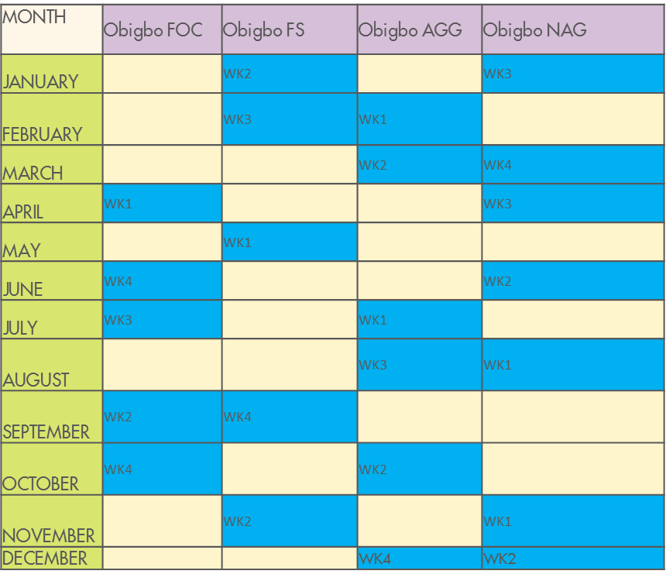
HSSE: OBIGBO PU PUM MFE PLAN FOR 2018

Slide 15
HSSE: OBIGBO PU DRILL PLAN FOR 2018
OBIGBO PU EMERGENCY RESPONSE DRILL PLAN FOR 2018
FACILITY | JAN | FEB | MAR | APR | MAY | JUN | JUL | AUG | SEPT | OCT | NOV | DEC
Obigbo FOC | PROCESS SAFETY |  |  | MAN LOST |  |  | SECURITY |  | FIRE | MOTOR VEHICLE
Obigbo FS |  | WELL HEAD FIRE |  |  | OIL SPILL |  |  | OIL SPILL |  |  | MAN LOST
Obigbo AGG |  |  |  | GAS LEAK |  |  | FIRE/ MEDVAC | FALL AT HEIGHT |  |  |  | MEDVAC AT NIGHT
Obigbo NAG | MEDEVAC |  | FIRE |  |  | PROCESS SAFETY |  |  |  | MEDVAC AT NIGHT | GAS LEAK

Slide 16
GROWING IPSC – CLOSED IN WELLS POTENTIAL
Focusing on the three buckets of possibilities, an estimate of what is required to deliver potential benefits as against expected barrels would help focus our energy and identify quick wins to pursue.

Slide 17
GROWING IPSC – CLOSED IN WELLS POTENTIAL
SN | Node | Field | Well | Conduit | Status @20.09.17 | Recommended Activity | Dependency (i.e reason for FUP) | Oil or Gas | Potential, Oil (bopd) | Proposal Category
1 | Obigbo | ISU | ISUZ001 | ISUZ001L | Signed FUP/Proposal | FLRR |  | Oil | 600 | Firm Proposal
2 | Obigbo | ISU | ISUZ001 | ISUZ001S | Signed FUP/Proposal | FLRR |  | Oil | 200 | Firm Proposal
3 | Obigbo | OBIGBO NORTH | OBGN005 | OBGN005L | Signed FUP/Proposal | Open Up (Post resolution of ROW) | ROW | Oil | 490 | FUP
4 | Obigbo | OBIGBO NORTH | OBGN005 | OBGN005S | Signed FUP/Proposal | Open Up (Post resolution of ROW) |  | Oil | 280 | FUP
5 | Obigbo | OBIGBO NORTH | OBGN009 | OBGN009L | Signed FUP/Proposal | Open Up (Post resolution of ROW) |  | Oil | 170 | FUP
6 | Obigbo | OBIGBO NORTH | OBGN009 | OBGN009S | Signed FUP/Proposal | WSO |  | Oil | 160 | Firm Proposal
7 | Obigbo | OBIGBO NORTH | OBGN010 | OBGN010T | Signed FUP/Proposal | Open Up (Post resolution of ROW)/WHM repair | ROW | Oil | 500 | FUP
8 | Obigbo | OBIGBO NORTH | OBGN013 | OBGN013L | Signed FUP/Proposal | Post encroachment restoration | ROW | Oil | 160 | FUP
9 | Obigbo | OBIGBO NORTH | OBGN013 | OBGN013S | Signed FUP/Proposal | Post encroachment restoration | ROW | Oil | 250 | FUP
10 | Obigbo | OBIGBO NORTH | OBGN015 | OBGN015T | Signed FUP/Proposal | Open Up (Post resolution of ROW)/WHM repair |  | Oil | 350 | FUP
11 | Obigbo | OBIGBO NORTH | OBGN017 | OBGN017L | Signed FUP/Proposal | Sidetrack opportunity into the D6000A |  | Oil | 500 | FUP
12 | Obigbo | OBIGBO NORTH | OBGN024 | OBGN024L | Signed FUP/Proposal | Post encroachment restoration | ROW | Oil | 300 | FUP
13 | Obigbo | OBIGBO NORTH | OBGN024 | OBGN024S | Signed FUP/Proposal | Post encroachment restoration | ROW | Oil | 600 | FUP
14 | Obigbo | OBIGBO NORTH | OBGN026 | OBGN026T | Signed FUP/Proposal | Post encroachment restoration | ROW | Oil | 70 | FUP
15 | Obigbo | OBIGBO NORTH | OBGN027 | OBGN027T | Signed FUP/Proposal | Post encroachment restoration | ROW | Oil | 700 | FUP
16 | Obigbo | OBIGBO NORTH | OBGN028 | OBGN028L | Signed FUP/Proposal | Resolve Integrity Issues and alternatively sidetrack to D1000W |  | Oil | 700 | FUP
17 | Obigbo | OBIGBO NORTH | OBGN033 | OBGN033L | Signed FUP/Proposal | Stimulation |  | Oil | 500 | Firm Proposal
18 | Obigbo | OBIGBO NORTH | OBGN035 | OBGN035S | Signed FUP/Proposal | Open Up (Post resolution of ROW) | ROW | Oil | 30 | FUP
19 | Obigbo | OBIGBO NORTH | OBGN036 | OBGN036L | Signed FUP/Proposal | Open Up (Post resolution of ROW) |  | Oil | 80 | FUP
20 | Obigbo | OBIGBO NORTH | OBGN037 | OBGN037S | Signed FUP/Proposal | Open Up (Economics of installation of GLL, FL and GLV) | Economics of installation of GLL, FL and GLV | Oil | 60 | FUP
21 | Obigbo | OBIGBO NORTH | OBGN039 | OBGN039T | Signed FUP/Proposal | Open Up (Post resolution of ROW) |  | Oil | 230 | FUP
22 | Obigbo | OBIGBO NORTH | OBGN045 | OBGN045L | Signed FUP/Proposal | Fix GL choke/GLVCO & Open up post encroachment resolution |  | Oil | 70 | FUP
23 | Obigbo | OBIGBO NORTH | OBGN045 | OBGN045S | Signed FUP/Proposal | Post encroachment restoration | ROW | Oil | 400 | FUP
24 | Obigbo | OBIGBO NORTH | OBGN048 | OBGN048L | Signed FUP/Proposal | Post encroachment restoration | ROW | Oil | 800 | FUP
25 | Obigbo | OBIGBO NORTH | OBGN049 | OBGN049L | Signed FUP/Proposal | Workover |  | Oil | 400 | FUP
26 | Obigbo | OBIGBO NORTH | OBGN051 | OBGN051L | Signed FUP/Proposal | Post encroachment restoration | ROW | Oil | 200 | FUP
27 | Obigbo | OBIGBO NORTH | OBGN051 | OBGN051S | Signed FUP/Proposal | Post encroachment restoration | ROW | Oil | 250 | FUP
28 | Obigbo | OBIGBO NORTH | OBGN054 | OBGN054T | Signed FUP/Proposal | Post encroachment restoration | ROW | Oil | 500 | FUP
29 | Obigbo | OBIGBO NORTH | OBGN055 | OBGN055T | Signed FUP/Proposal | Open Up (Post resolution of ROW) | ROW | Oil | 400 | FUP
 |  |  |  |  |  |  |  | Total | 9950

Slide 18
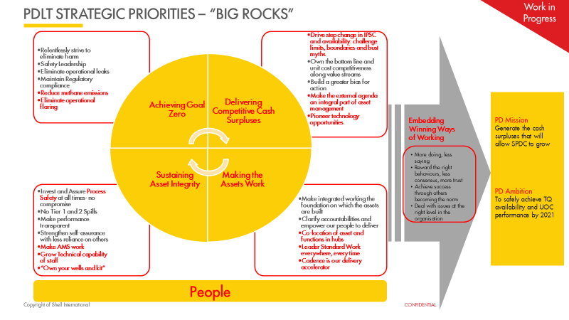
PDLT FOCUS

